Slide 1
Sustainable Product / Lifestyle Recommender System
Submitted to:
Dr. Shilpa Verma
Assistant Professor
Computer Science and Engineering
Department
Submitted by:
Piyush Goyal (22106019)
Sanidhya Shyam Sagar (22106024)
Parth (22106026)

Slide 2
Introduction
Increasing climate change and environmental degradation have made sustainable living a global priority.
Daily lifestyle choices such as transportation, diet, energy usage, and consumption habits significantly impact the environment.
Despite awareness, individuals often lack personalized guidance to adopt sustainable practices.
Existing solutions provide generic recommendations, which may not suit individual lifestyles.
This project introduces a Sustainable Lifestyle & Product Recommendation System.
The system also recommends eco-friendly products based on user lifestyle patterns.

Slide 3
Problem Statement
Increasing environmental concerns require a shift toward sustainable product usage
Many users are willing to adopt eco-friendly alternatives but face difficulty in identifying suitable products
Online platforms provide a large number of options, but lack focused filtering for sustainability needs
Users do not have a simple system that connects their lifestyle choices to relevant eco-friendly products
Existing solutions are often complex or not user-friendly for quick decision-making
There is a need for a simple and effective system that takes user inputs related to their lifestyle and recommends relevant eco-friendly products to user based on their choices.

Slide 4
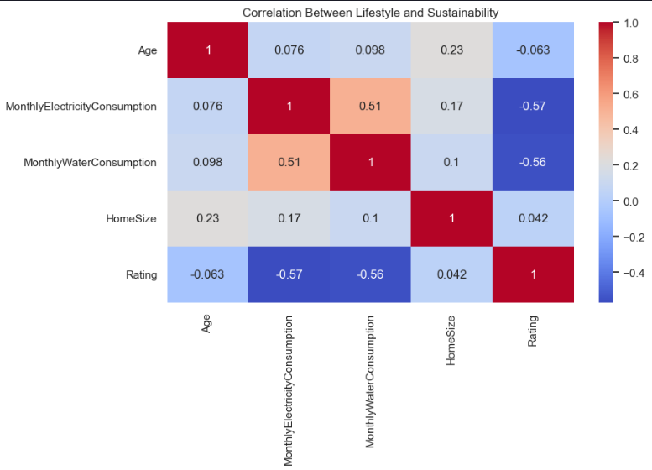
Objectives
To collect user inputs related to basic lifestyle habits through a form
To identify user needs based on inputs such as transport, energy usage, and consumption
To map user inputs to relevant eco-friendly product categories
To develop a simple system that suggests relevant sustainable products
To provide an easy-to-use interface for quick and effective decision-making

Slide 5
Dataset Used
We have used two datasets for this project:
Sustainable Lifestyle Rating Dataset: It has 20 columns and data from 500 participants. Features included like Diet habits (veg/non-veg, frequency), Transportation mode (car, public transport, etc.), Energy consumption (electricity source, usage), Shopping and consumption behavior. Used to analyze user behavior.
Amazon Eco-Friendly Products Dataset: Contains eco-friendly product information, it has 14 columns and 343l products data. Includes features like Product name and category, Sustainability tags (eco-friendly, reusable, energy-efficient), Price and description. Used to recommend sustainable alternatives.

Slide 6
Data Preprocessing
Collected two datasets: - Lifestyle dataset (user habits) - Amazon eco-friendly products dataset
Data Cleaning: - Removed missing and duplicate values - Handled inconsistent or irrelevant entries
Feature Selection: - Selected important attributes such as transport, diet, energy, and consumption - Extracted relevant product fields like name, category, and description
Data Transformation: - Converted categorical values into a consistent format (e.g., lowercase) - Combined product attributes (name + category + description) for better matching
Text Processing (for product dataset): - Removed special characters and unnecessary text - Prepared text for keyword-based filtering

Slide 7
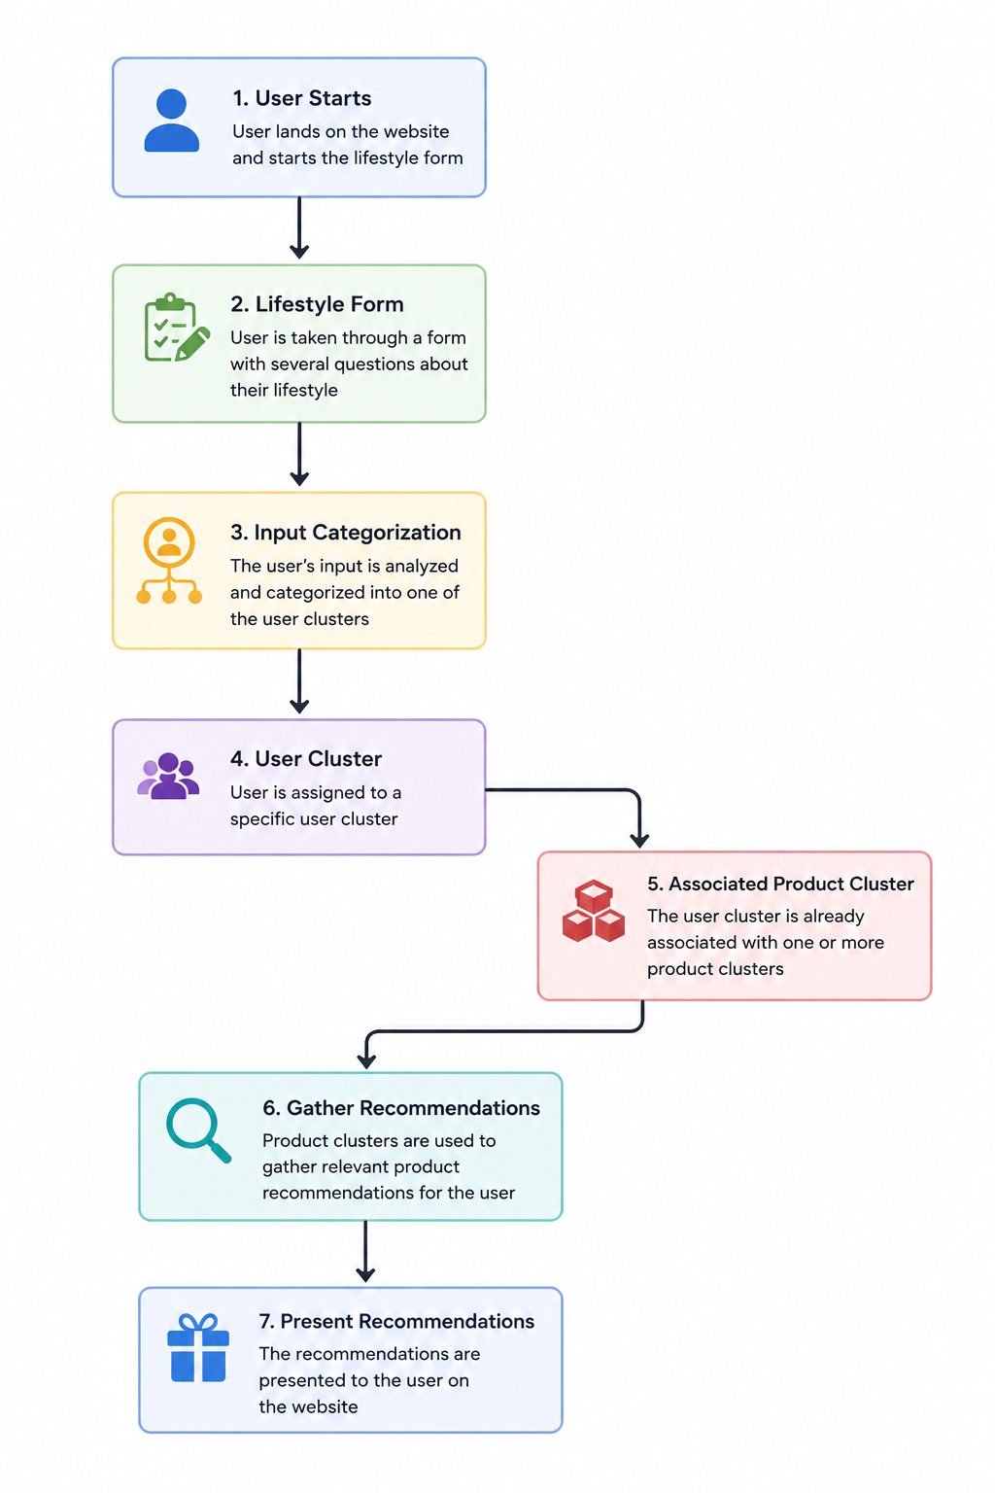
Working
In this project we take user through a form in which several questions are asked user about their lifestyle.
After user has given input, we categorize the input into one of the user clusters.
The user clusters are already associated with product clusters, which are then used to gather recommendations for the user.
These recommendations are the presented to the user on the website.

Slide 8
Techniques used for recommendation
TF-IDF Vectorization
We used TF-IDF to convert terms into numerical vectors for our clustering algorithm.
This is a simple and quick vectorization method for our use-case.
This method is however susceptible to noise, e.g. brands names
K-Means Clustering
We used K-Means to cluster user data and product data
K-Means clustering is very useful for our use case of cold start users
These clusters can be used to further associate products and user clusters as we get more user buying data.

Slide 9
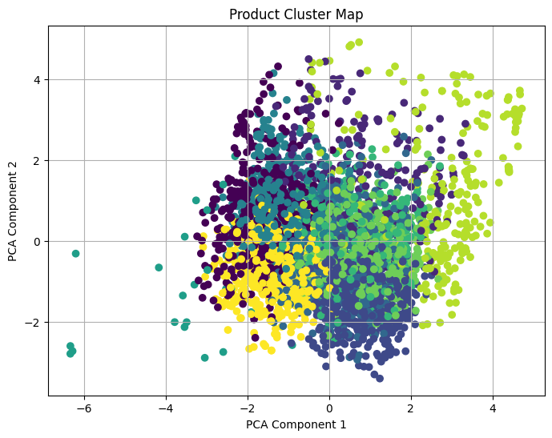
Product Data Clustering
We made 10 clusters of products for our model.
The graph visualizes eco-friendly Amazon products grouped into different clusters using the K-Means clustering algorithm.
Products with similar characteristics are placed closer together in the graph.
PCA (Principal Component Analysis) is used to reduce high-dimensional data into 2 dimensions for visualization.
Each color represents a different product cluster.
Clustering helps identify categories of sustainable products with similar features and user preferences.
These clusters can later be used to recommend products based on user lifestyle patterns and sustainability behavior.

Slide 10
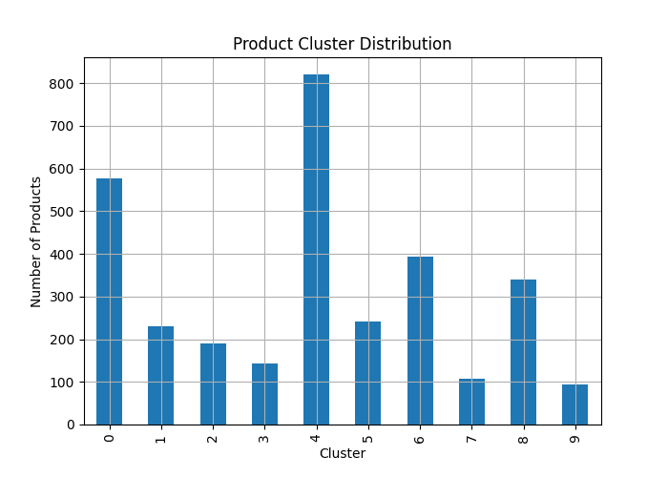
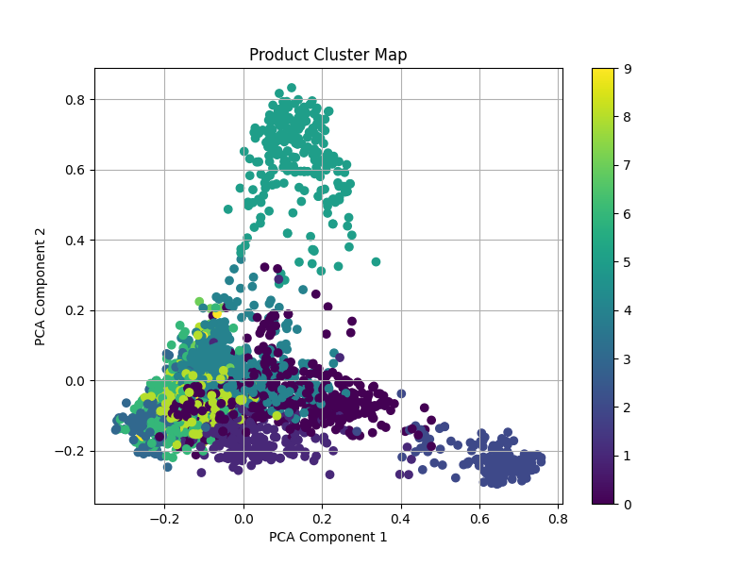
Model Validation

Slide 11
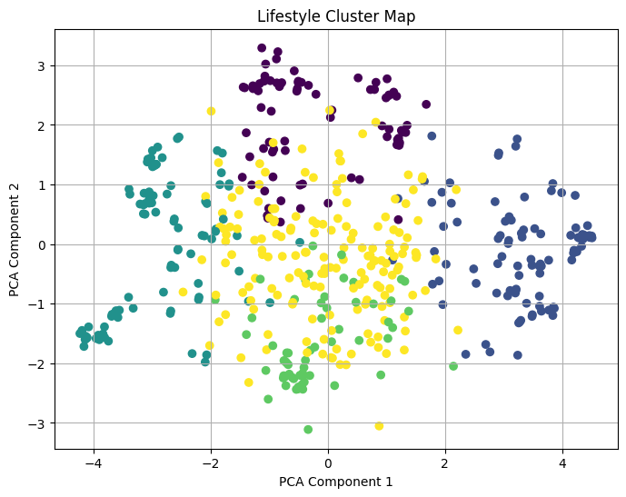
Lifestyle Data Clustering
We have made 5 clusters of user lifestyle data.
The graph visualizes users grouped according to their sustainability lifestyle patterns.
Users with similar habits such as transportation, energy usage, diet, and consumption patterns are grouped together.
K-Means clustering is used to identify hidden patterns in the lifestyle dataset.
PCA reduces the dataset dimensions to make the clusters easier to visualize.
Different colors represent different lifestyle groups or sustainability levels.
These clusters help in understanding user behavior and enable personalized eco-friendly product recommendations.

Slide 12
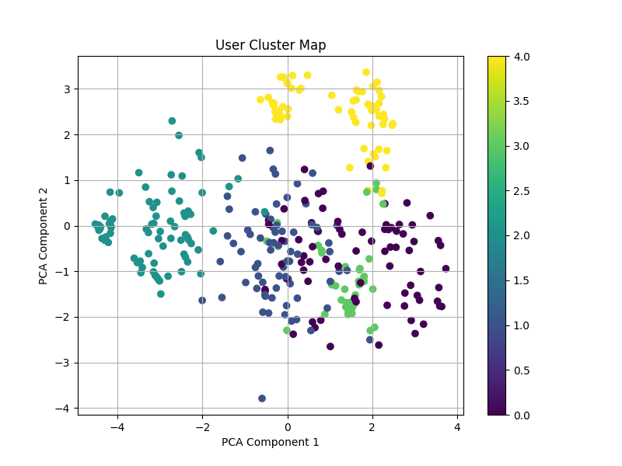
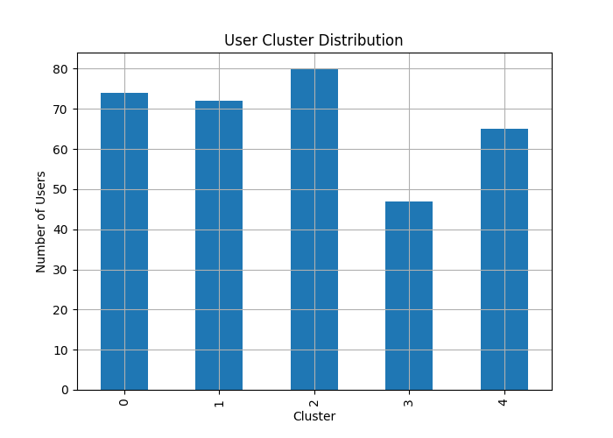
Model Validation

Slide 13
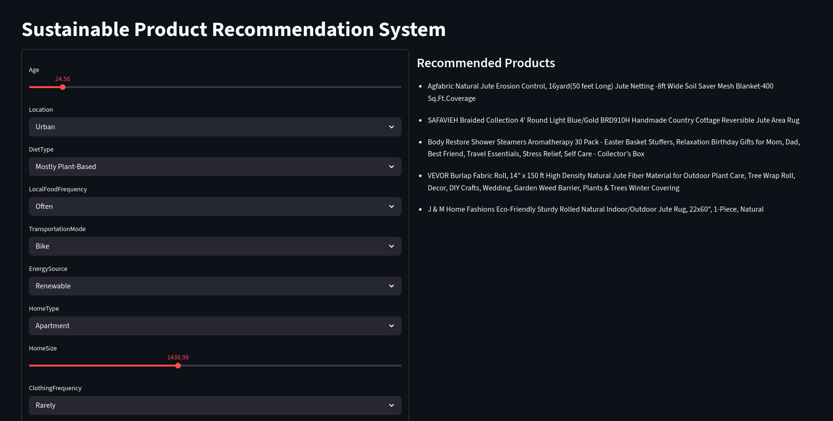
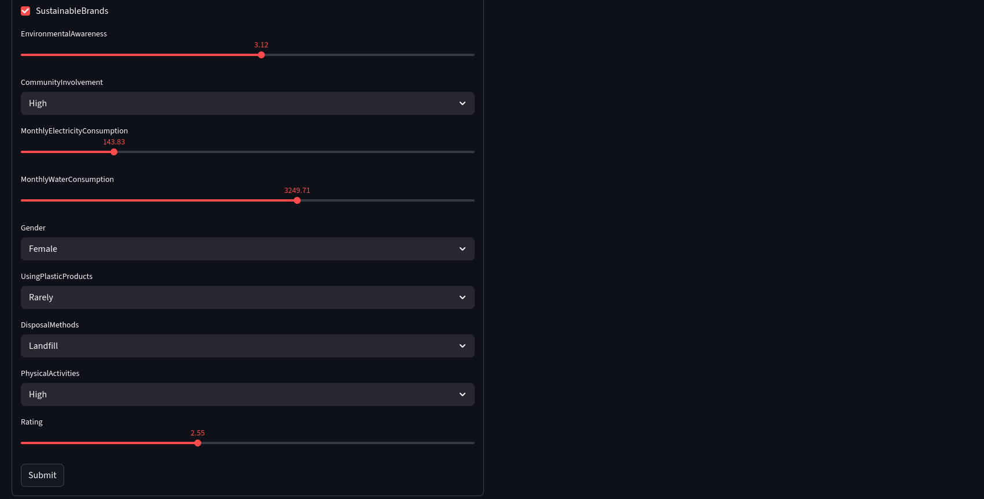
Website
We made a Streamlit application based form for our user, where they can answer questions about their lifestyle, which will be used to place them in a specific user cluster.
This user cluster is then used to recommend products from clusters correlated to the user cluster.
Thus we can get product recommendations with a cold start user.

